Slide 1

Group 16
Aditya Oak
Kaushik Bhat
Sameer Sathe
Satish Motiani
Saurabh Goel
Shiv Balaji Ramesh

Slide 2

Indian Premier League
Analytic study of deliveries over past 9 seasons to help firms advertise better for an on-going match

Slide 3
Introduction
Started in 2008, currently in its 10th season
Franchise based cricket league in the international 20-20 format
11 players in every team
Every over has 6 deliveries

Slide 4
Dataset characteristics
Records of each delivery ever played over the past 9 seasons of IPL
List of attributes
Match id | Bye runs
Innings | Legbye
Batting team | No ball
Bowling team | Penalty
Over | Batsman runs
Ball | Extra runs
Batsman | Total runs
Non-striker | Player dismissed
Bowler | Dismissal kind
Is super over | Fielder
Wide runs
2,477,110 values
21 Attributes
13 Quantitative
8 Qualitative
Source: kaggle.com

Slide 5
Dataset characteristics

Slide 6
Data cleaning
Discarded attributes (Domain knowledge)
Match id | Batsman runs
Innings | Extra runs
Over | Player dismissed
Ball | Dismissal kind
Non-striker | Fielder
Is super over
Wide runs
Bye runs
Legbye
No ball
Penalty
Retained attributes
Batting team
Bowling team
Batsman
Bowler
Total runs
682,995 values
5 attributes
All qualitative

Slide 7
Pre-processing
Objective is to capture only the 4’s, 6’s and ‘Wickets’ from the target attribute
Converted the target attribute from quantitative to qualitative
Replaced 4’s and 6’s with ‘Four’ and ‘Six’ respectively
Replaced 1’s, 2’s and 3’s with ‘Zero’
5’s with ‘Four’
7’s with ‘Six’
0’s corresponding to a wicket ball replaced with the word ‘Wicket’
Ultimately, the class attribute consists of only ‘Zero’, ‘Four’, ‘Six’ and ‘Wicket’

Slide 8
Algorithms Used
J48
Naïve-Bayes
One-R
Decision Table

Slide 9
Factors used
Factors | 80/20 split | 60/40 split
10% noise | C1 | C2
20% noise | C3 | C4

Slide 10
J48
Seed No. | C1 (80/20-10%N) | C2(60/40-10%N) | C3(80/20-20%N) | C4(60/40-20%N)
1 | 71.7972 | 71.8919 | 59.1801 | 59.5582
2 | 71.8814 | 71.6594 | 59.1215 | 59.2105
3 | 71.9912 | 71.9962 | 59.3302 | 59.3624
4 | 71.9143 | 71.923 | 59.1764 | 59.2562
5 | 71.6874 | 71.729 | 59.213 | 59.2928
6 | 72.2365 | 71.9797 | 59.4546 | 59.2928
7 | 72.0205 | 72.1261 | 59.2826 | 59.3386
8 | 71.7313 | 71.9816 | 58.836 | 59.3111
9 | 71.8851 | 71.9541 | 59.5864 | 59.4484
10 | 71.8924 | 71.8626 | 59.5754 | 59.3532
Avg | 71.90373 | 71.9104 | 59.2756 | 59.3424
St Dev | 0.1567 | 0.13514 | 0.22643 | 0.09948

Slide 11
Naïve-Bayes
Seed No. | C1 (80/20-10%N) | C2(60/40-10%N) | C3(80/20-20%N) | C4(60/40-20%N)
1 | 71.7972 | 71.7876 | 64.6266 | 64.6846
2 | 71.8814 | 71.5972 | 64.4473 | 64.3862
3 | 71.9912 | 71.9193 | 64.7401 | 64.6443
4 | 71.9143 | 71.8388 | 64.5498 | 64.6077
5 | 71.6874 | 71.6338 | 64.5791 | 64.5272
6 | 72.2365 | 71.9065 | 64.6633 | 64.4832
7 | 72.0205 | 72.0914 | 64.8755 | 64.8456
8 | 71.7313 | 71.8662 | 64.2826 | 64.6059
9 | 71.8851 | 71.8791 | 64.7548 | 64.6095
10 | 71.8924 | 71.7821 | 64.9012 | 64.4997
Avg | 71.90373 | 71.8302 | 64.64203 | 64.58939
St Dev | 0.156697629 | 0.142492666 | 0.189818299 | 0.126143767

Slide 12
One-R
Seed No. | C1 (80/20-10%N) | C2(60/40-10%N) | C3(80/20-20%N) | C4(60/40-20%N)
1 | 71.7826 | 54.8125 | 59.1435 | 46.8475
2 | 71.8631 | 54.4977 | 59.0813 | 46.6626
3 | 71.9802 | 54.5252 | 59.2936 | 46.4375
4 | 71.9107 | 54.7246 | 59.1471 | 46.7121
5 | 71.6728 | 54.7448 | 59.1911 | 46.5913
6 | 72.2328 | 54.4959 | 59.4034 | 46.4394
7 | 72.0205 | 54.7576 | 59.2679 | 46.8859
8 | 71.7167 | 54.5435 | 58.7848 | 46.5254
9 | 71.8851 | 54.7979 | 59.5534 | 46.6974
10 | 71.8741 | 54.5508 | 59.5168 | 46.5693
Avg | 71.89386 | 54.64505 | 59.23829 | 46.63684
St Dev | 0.160797161 | 0.132441025 | 0.225557603 | 0.154264234

Slide 13
Decision Table
Seed/S.No | C1 (80/20-10%N) | C2(60/40-10%N) | C3(80/20-20%N) | C4(60/40-20%N)
1 | 54.5095 | 54.9003 | 36.8448 | 36.9589
2 | 54.634 | 54.5489 | 37.0425 | 37.034
3 | 54.5681 | 54.5801 | 36.8155 | 36.5966
4 | 54.4985 | 54.796 | 36.5739 | 36.8821
5 | 54.8133 | 54.8052 | 37.0278 | 37.0047
6 | 54.8097 | 54.591 | 36.7277 | 36.624
7 | 54.8646 | 54.8198 | 36.9949 | 36.9882
8 | 54.0739 | 54.5947 | 36.6252 | 36.6259
9 | 55.0732 | 54.8418 | 37.295 | 36.7137
10 | 54.8609 | 54.6313 | 37.0864 | 36.7503
Avg | 54.67057 | 54.71091 | 36.90337 | 36.81784
St Dev | 0.278711 | 0.125924 | 0.214017 | 0.165366

Slide 14
Performance across algorithms

Slide 15
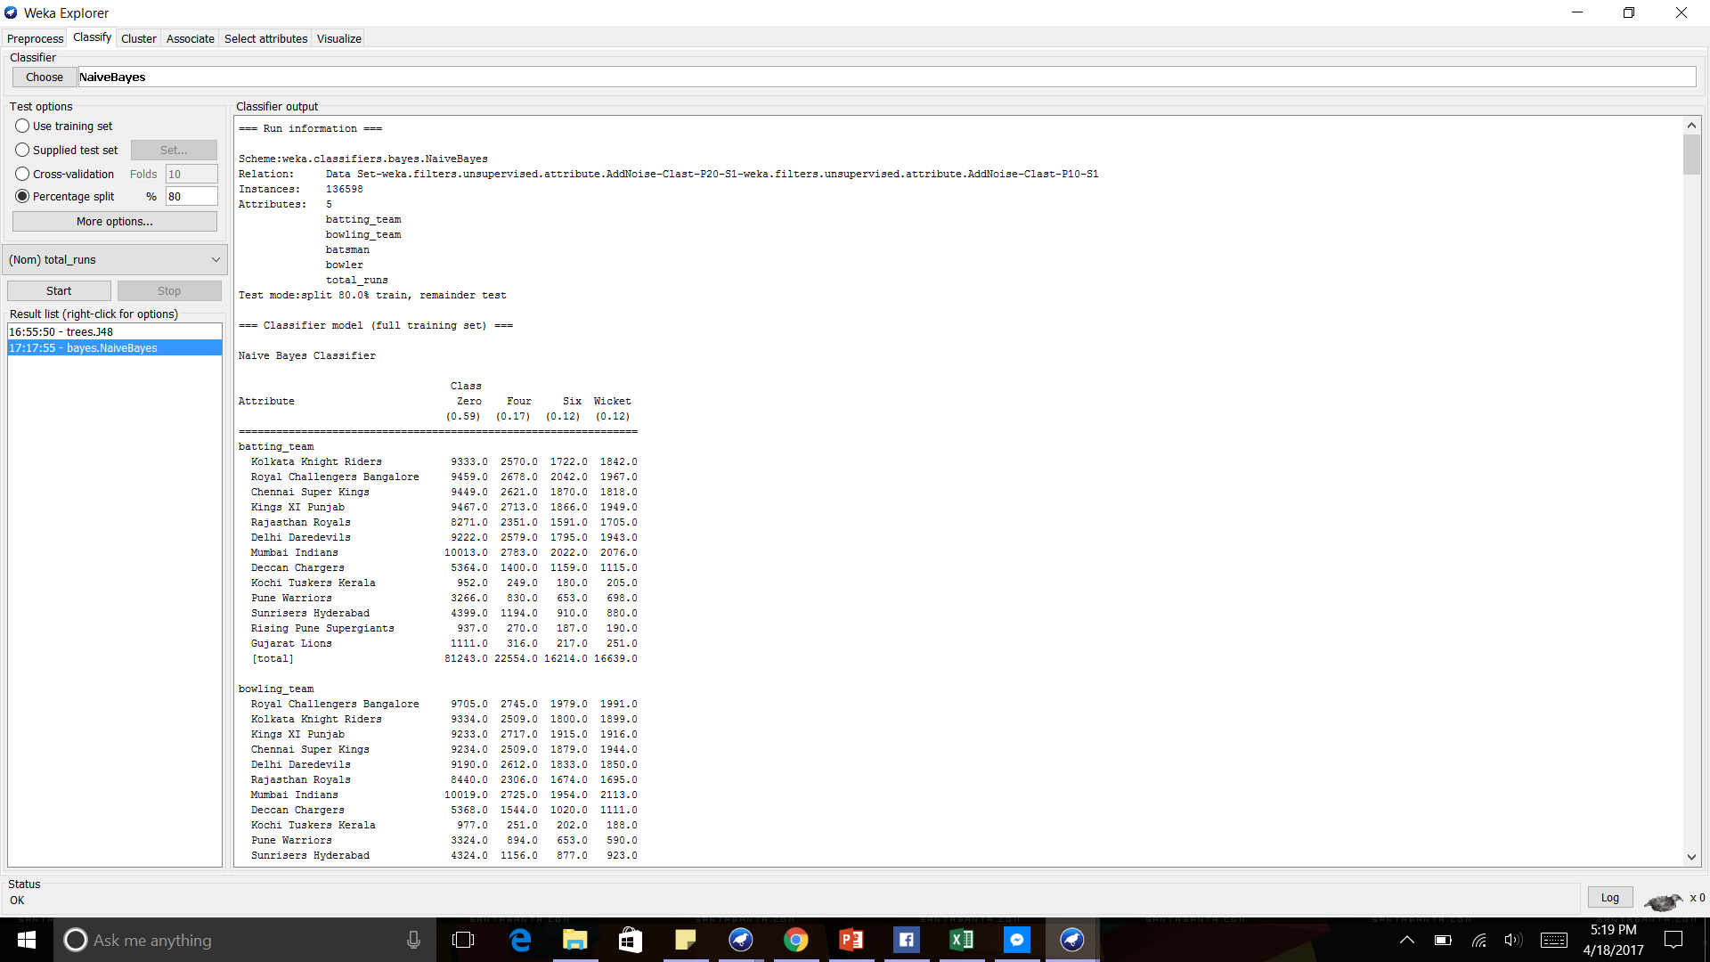
Conclusion
Post analysis across all considered classifiers, Naïve Bayes seems to maintain the accuracy closest even with 20% noise in the dataset.
Model for Naïve Bayes depicts a fairly equal weightage for all the used attributes as it uses a probabilistic approach.

